Slide 1

Deep Learning
Stan Z. Li, Tao Lin
Lecture 9: Attention
Stan Z. Li

Slide 2
Outline
Sequence Modeling and RNN
Attention Mechanism
2. SE-Net
3. Transformer
3. Vision Transformer

Slide 3
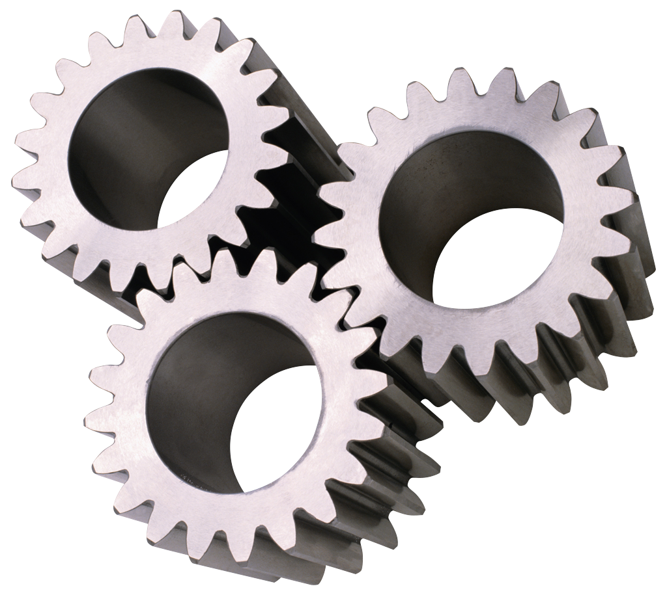
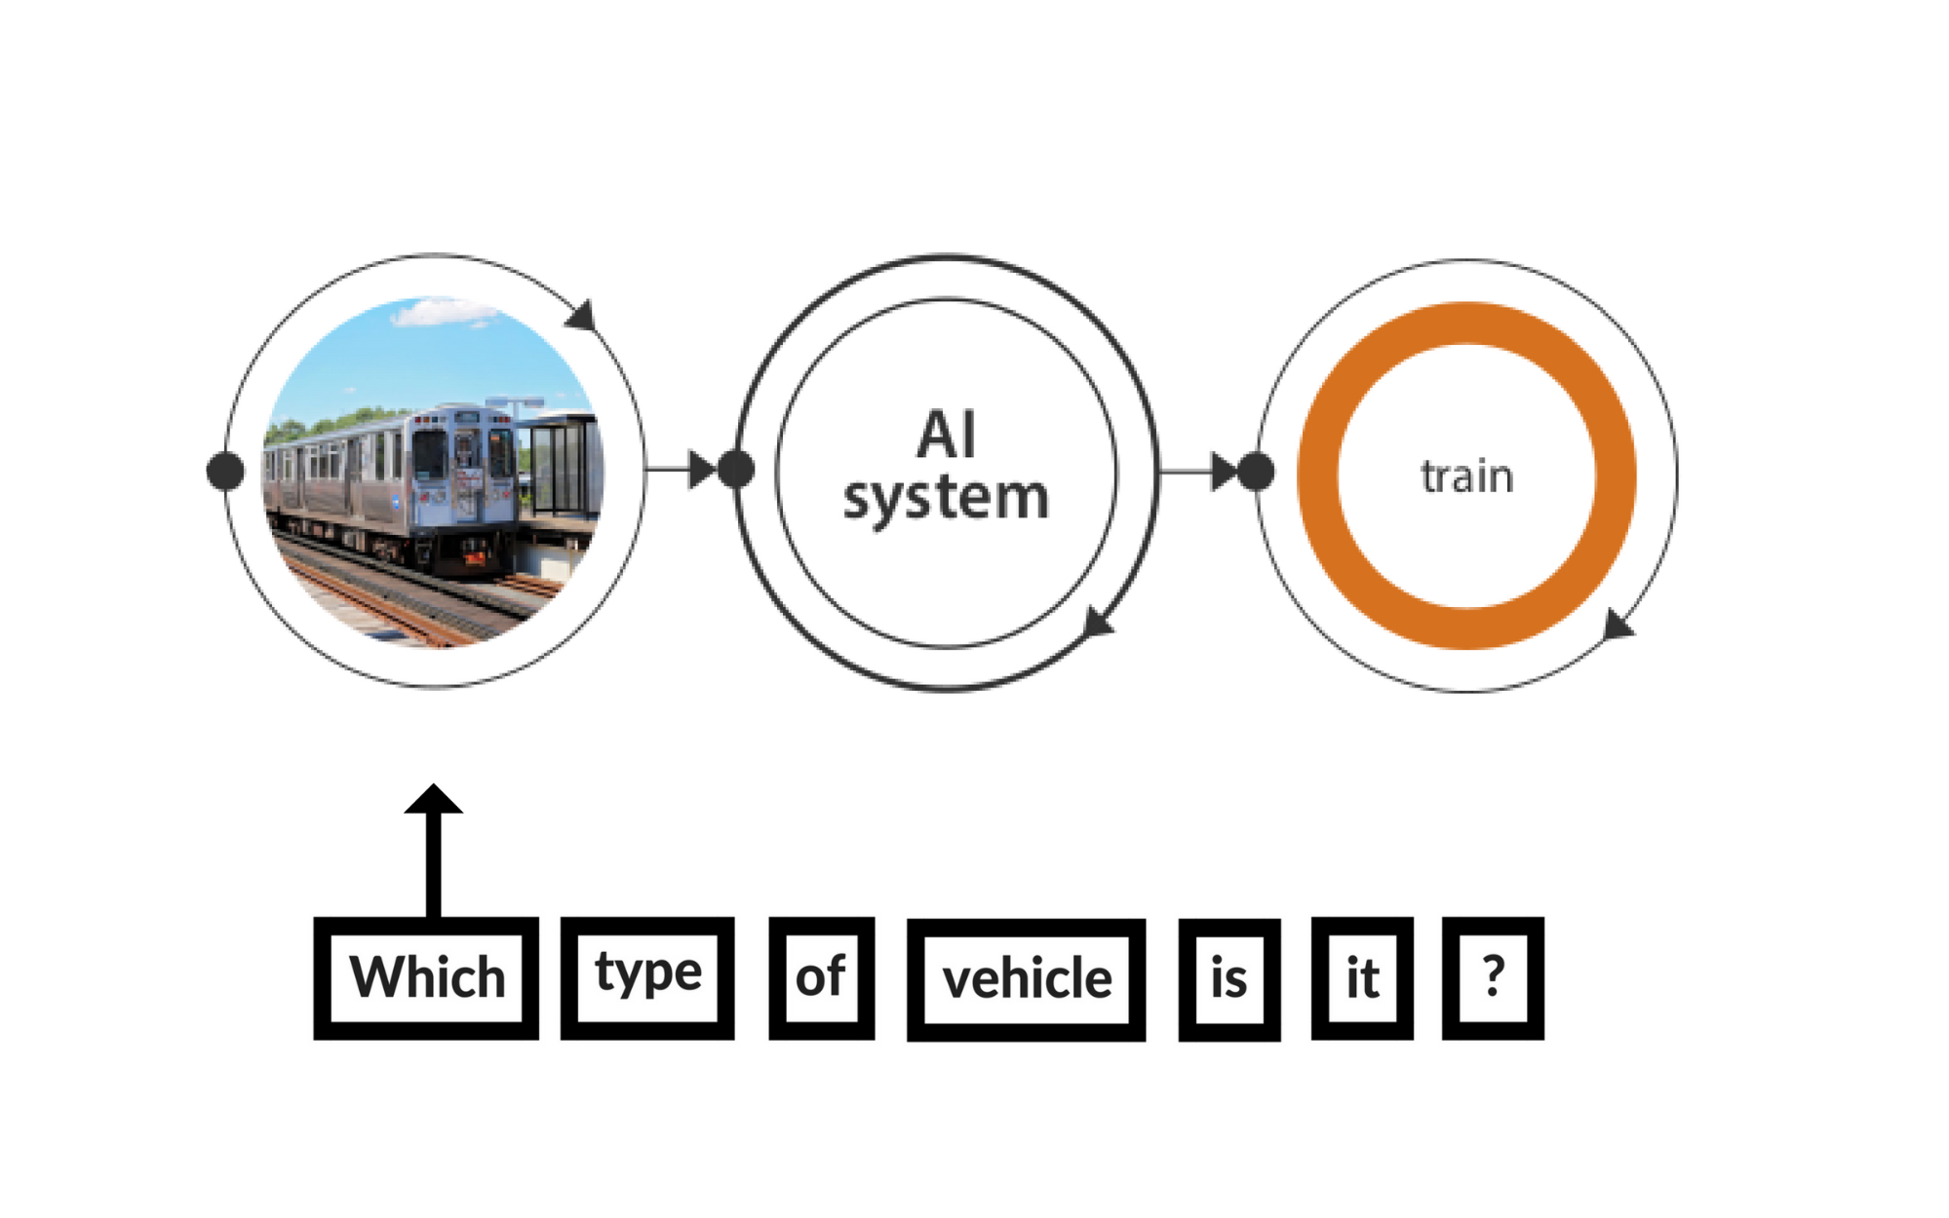

Sequence Modeling and RNN
- Sequence Modeling
Goal: Develop an architecture capable of generating contextually appropriate, arbitrary length, output sequences
Applications:
Machine translation,
Question answering
··· ···
欢迎来到深度学习课程
Welcome to the deep learning class
Notes:
that are capable of generating
contextually appropriate, arbitrary length, output sequences. Encoder-decoder networks
have been applied to a very wide range of applications including machine
translation, summarization, question answering, and dialogue modeling.

Slide 4
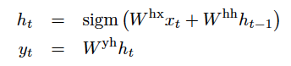
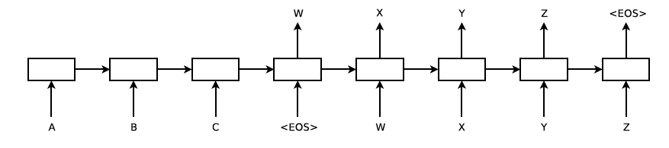
Sequence Modeling and RNN
- Sequence Modeling
MLP:
Transform MLP into a recurrent way
RNN:
W X Y Z
A B C
Every single unit is a MLP
While the hidden state flows through the sequence
Fixed input length
Fixed output length
Notes:
that are capable of generating
contextually appropriate, arbitrary length, output sequences. Encoder-decoder networks
have been applied to a very wide range of applications including machine
translation, summarization, question answering, and dialogue modeling.

Slide 5
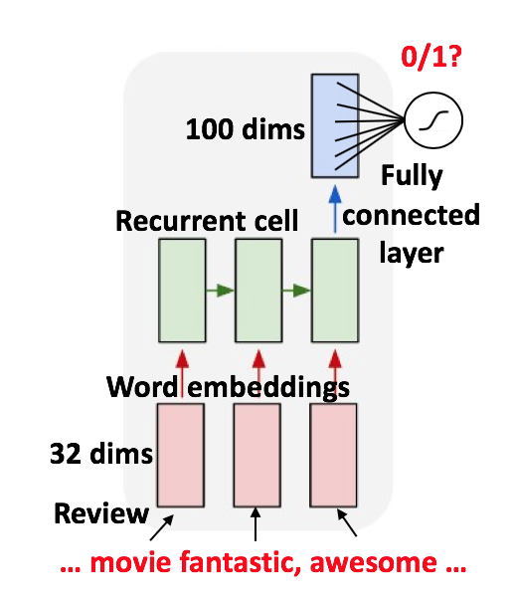
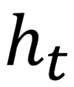

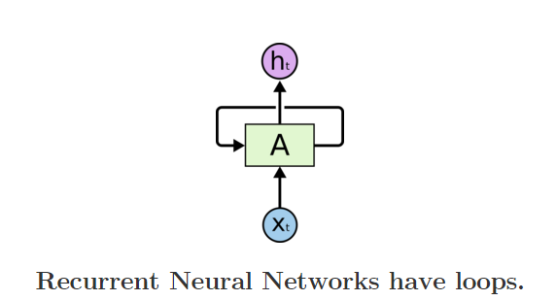
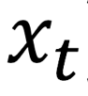
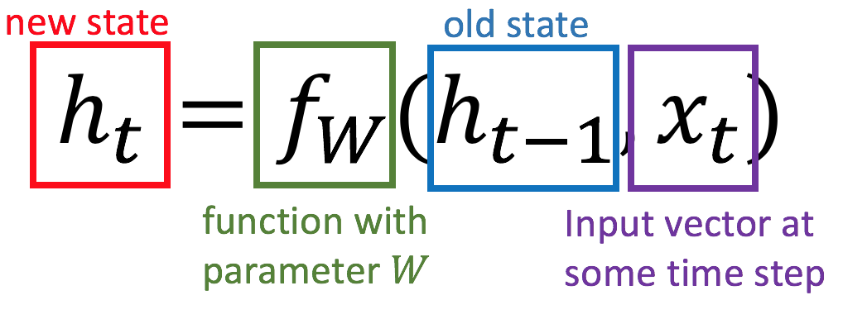
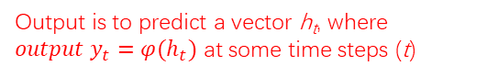
Sequence Modeling and RNN
- RNN
Recurrent Neural Networks are networks with loops, allowing information to persist.
Output is to predict a vector h_{t}, where ${output y}_{t}=φ(h_{t})$ at some time steps (t)
In the above diagram, a chunk of neural network, A = f_{W}, looks at some input xt and outputs a value ht. A loop allows information to be passed from one step of the network to the next.
Notes:
that are capable of generating
contextually appropriate, arbitrary length, output sequences. Encoder-decoder networks
have been applied to a very wide range of applications including machine
translation, summarization, question answering, and dialogue modeling.

Slide 6


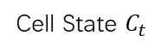
Sequence Modeling and RNN
- RNN Units
Long Short-Term Memory (LSTM)
The key to LSTMs is the cell state.
Stores information of the past → long-term memory
Passes along time steps with minor linear interactions → “additive”
Results in an uninterrupted gradient flow → errors in the past pertain and impact learning in the future
The LSTM cell manipulates input information with three gates.
Input gate → controls the intake of new information
Forget gate → determines what part of the cell state to be updated
Output gate → determines what part of the cell state to output
Cell State $C_{t}$
Gradient Flow
Notes:
that are capable of generating
contextually appropriate, arbitrary length, output sequences. Encoder-decoder networks
have been applied to a very wide range of applications including machine
translation, summarization, question answering, and dialogue modeling.

Slide 7

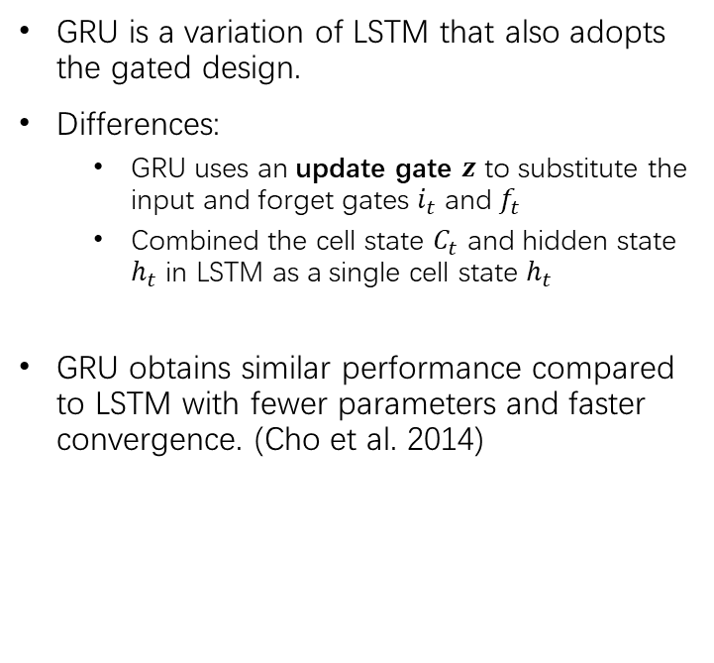
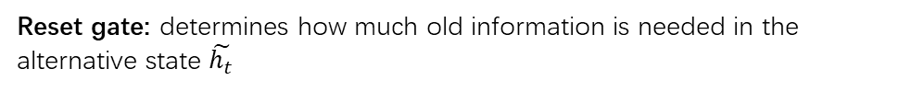
Sequence Modeling and RNN
- RNN Units
Gated Recurrent Unit (GRU)
GRU is a variation of LSTM that also adopts the gated design.
Differences:
GRU uses an update gate $z$ to substitute the input and forget gates $i_{t}$ and $f_{t}$
Combined the cell state $C_{t}$ and hidden state $h_{t}$ in LSTM as a single cell state $h_{t}$
GRU obtains similar performance compared to LSTM with fewer parameters and faster convergence. (Cho et al. 2014)
Update gate: controls the composition of the new state
Reset gate: determines how much old information is needed in the alternative state $\tilde{h_{t}}$
Alternative state: contains new information
New state: replace selected old information with new information in the new state
Notes:
that are capable of generating
contextually appropriate, arbitrary length, output sequences. Encoder-decoder networks
have been applied to a very wide range of applications including machine
translation, summarization, question answering, and dialogue modeling.

Slide 8
Attention Mechanism
- previously on Sequence Modeling
RNN: input sequence is transformed into output sequence in a one-to-one fashion.
Goal: Develop an architecture capable of generating contextually appropriate, arbitrary length, output sequences
Applications:
Machine translation,
Summarization,
Question answering,
Dialogue modeling.
Notes:
that are capable of generating
contextually appropriate, arbitrary length, output sequences. Encoder-decoder networks
have been applied to a very wide range of applications including machine
translation, summarization, question answering, and dialogue modeling.

Slide 9
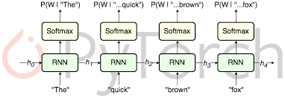
Attention Mechanism
- previously on Sequence Modeling
RNN Applications:
Language Modeling
Sequence Classification (Sentiment, Topic)
Sequence to Sequence
Notes:
Simple recurrent networks have proven to be an effective approach to language modeling,
sequence labeling tasks such as part-of-speech tagging, as well as sequence
classification tasks such as sentiment analysis and topic classification.
they form the basic building blocks for sequence to sequence approaches to applications such as summarization and machine translation.

Slide 10
Attention Mechanism
- previously on Sequence Modeling
Encoder-Decoder Network Structures
Encoder generates a contextualized representation of the input (last state).
Decoder takes that state and autoregressively generates a sequence of outputs
Notes:
Basic RNN-based encoder-decoder architecture. The final hidden state of the encoder RNN
serves as the context for the decoder in its role as h0 in the decoder RNN.

Slide 11






Attention Mechanism
- General Encoder-Decoder Network
Abstracting away from RNN choice
Encoder: accepts an input sequence, x_{1:n} and generates a corresponding sequence of contextualized representations, h_{1:n}
Context vector c: function of h_{1:n} and conveys the essence of the input to the decoder.
Decoder: accepts c as input and generates an arbitrary length sequence of hidden states h_{1:m} from which a corresponding sequence of output states y_{1:m} can be obtained.
h₁
h₂
h_{m}
h₁
h₂
h_{n}
Notes:
Basic RNN-based encoder-decoder architecture. The final hidden state of the encoder RNN
serves as the context for the decoder in its role as h0 in the decoder RNN.

Slide 12
Attention Mechanism
- Flexible context: Attention
Context vector c: function of h_{1:n} and conveys the essence of the input to the decoder.
Flexible?
Different for each h_{i}
Flexibly combining the h_{j}
h₁
h₂
h_{m}
h₁
h₂
h_{n}
Notes:
we’ll need a mechanism that can take the entire encoder context into account, that dynamically
updates during the course of decoding, and that can be embodied in a fixed-size
attention vector. Taken together, we’ll refer such an approach as an attention mechanism.

Slide 13
Attention Mechanism
- Flexible context: Attention
dynamically derived context:
Replace static context vector with dynamic c_{i}
derived from the encoder hidden states at each point i during decoding
Ideas:
should be a linear combination of those states
should depend on ?
Notes:
Replace the static context vector with one that is dynamically derived from the encoder hidden states at each point during decoding

Slide 14
Attention Mechanism
- Flexible context: How to compute the weights?
Compute a vector of scores that capture the relevance of each encoder hidden state to the decoder state
Similarity is a good choice
Give network the ability to learn which aspects of similarity between the decoder and encoder states are important to the current application.
Notes:
The first step in computing c_i is to compute a vector of scores that capture the
relevance of each encoder hidden state to the decoder state captured in hdi
For now, let’s assume that this score provides us with a measure of how similar
the decoder hidden state is to each encoder hidden state
By introducing Ws to the score, we are giving the network the ability to learn which
aspects of similarity between the decoder and encoder states are important to the
current application.

Slide 15
Attention Mechanism
- Flexible context: How to compute the weights?
Create vector of weights by normalizing scores
Notes:
To make use of these scores, we’ll next normalize them with a softmax to create
a vector of weights, ai j, that tells us the proportional relevance of each encoder
hidden state j to the current decoder state, i.
Finally, given the distribution in a, we can compute a fixed-length context vector for
the current decoder state by taking a weighted average over all the encoder hidden
states.

Slide 16
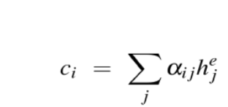
Attention Mechanism
- Flexible context: Weighted Summation
Summation
Notes:
To make use of these scores, we’ll next normalize them with a softmax to create
a vector of weights, ai j, that tells us the proportional relevance of each encoder
hidden state j to the current decoder state, i.
Finally, given the distribution in a, we can compute a fixed-length context vector for
the current decoder state by taking a weighted average over all the encoder hidden
states.

Slide 17
SE-Net
- Squeeze-and-Excitation Network
Look back to Computer Vision
During the early days of attention mechanisms in computer vision, one paper published at CVPR 2018 (and TPAMI), Squeeze and Excitation Networks, introduced a novel channel attention mechanism. This simple yet efficient add-on module can be added to any baseline architecture to get an improvement in performance, with negligible computational overhead.
Image tensor is usually denoted by a (B, C, H, W) dimensionality
If a network can be enhanced from the aspect of channel relationship?
• Explicitly model channel-interdependencies within modules
• Selectively enhance useful features and suppress less useful ones
Notes:
Image tensor is usually denoted by a (B, C, H, W) dimensionality,
where B refers to the batch size, C refers to the channels, and the H, W refers to the spatial dimensions of the feature maps (H represents the height and W represents the width).
The channels are the result of the convolutional filters deriving different features from the input.
However, the channels might not have the same representative importance.
As some channels might be more important than others, it makes sense to apply a weight to the channels based on their importance before propagating to the next layer.

Slide 18
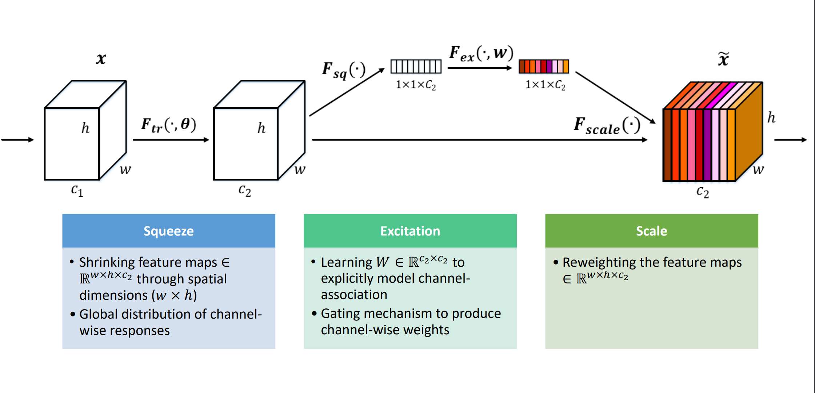
SE-Net
- Squeeze-and-Excitation Network
SE-Module
Notes:
Image tensor is usually denoted by a (B, C, H, W) dimensionality,
where B refers to the batch size, C refers to the channels, and the H, W refers to the spatial dimensions of the feature maps (H represents the height and W represents the width).
The channels are the result of the convolutional filters deriving different features from the input.
However, the channels might not have the same representative importance.
As some channels might be more important than others, it makes sense to apply a weight to the channels based on their importance before propagating to the next layer.

Slide 19
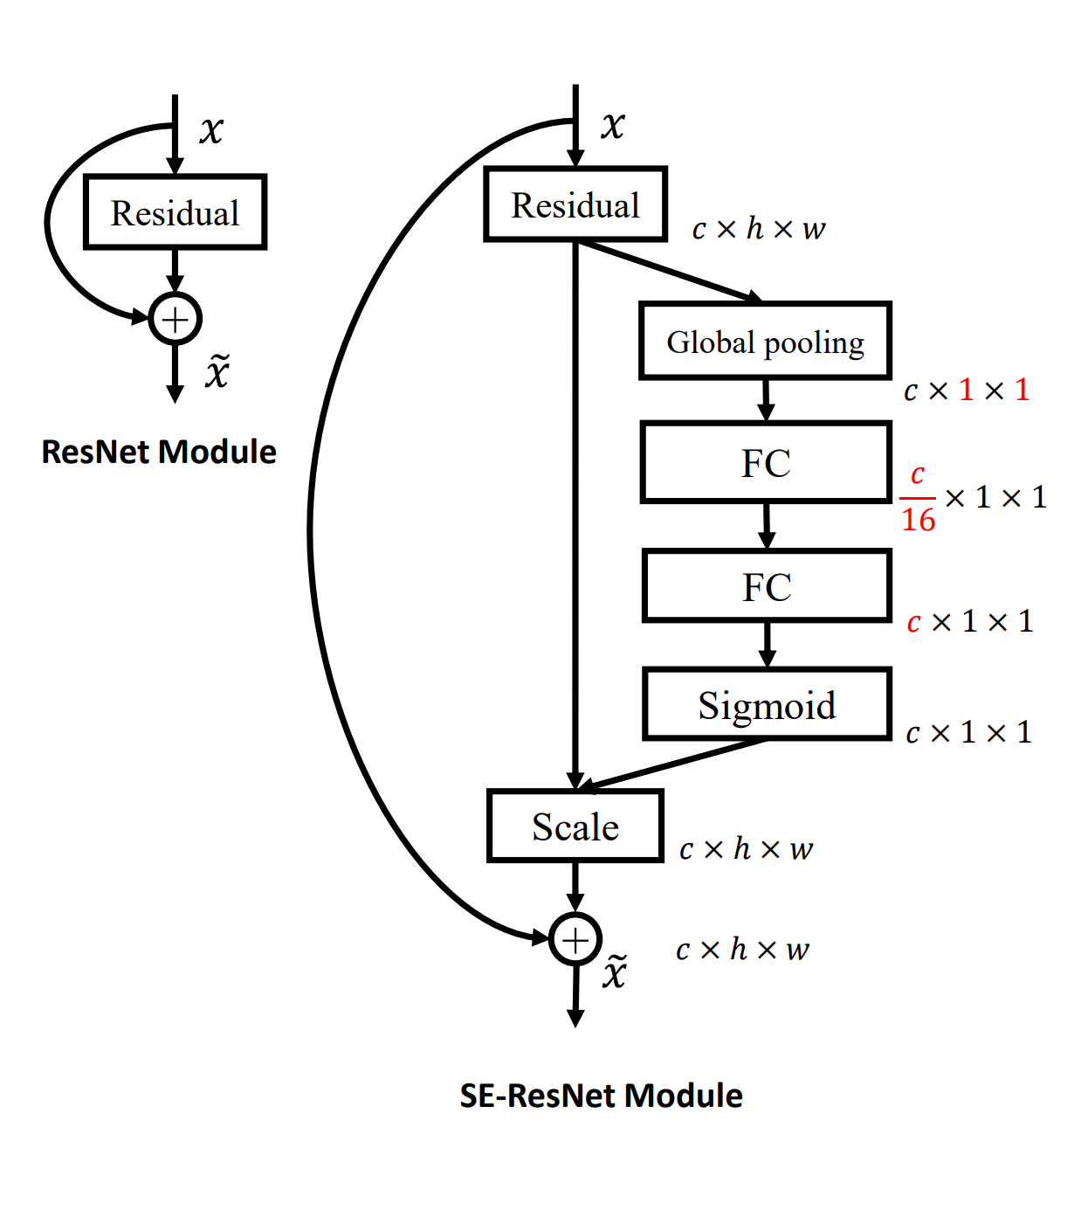
SE-Net
- Squeeze-and-Excitation Network
SE-Module

Slide 20
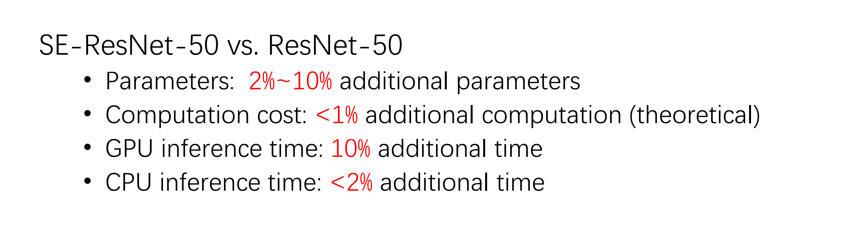
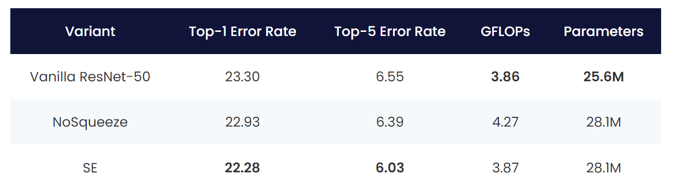
SE-Net
- Squeeze-and-Excitation Network
Performance

Slide 21
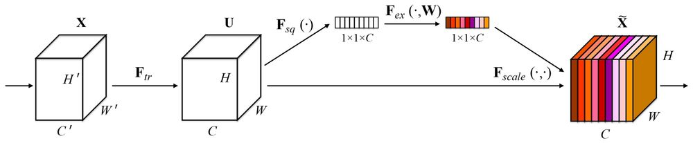
SE-Net
- Squeeze-and-Excitation Network
Why attention
In total, you pass the (C ×1×1) tensor as input and obtain a weighted tensor of the same shape – (C ×1×1).
It can be regarded as CHANNEL ATTENTION.
In comparison, the former attention in sequence modeling is regarded as TOKEN ATTENTION.

Slide 22
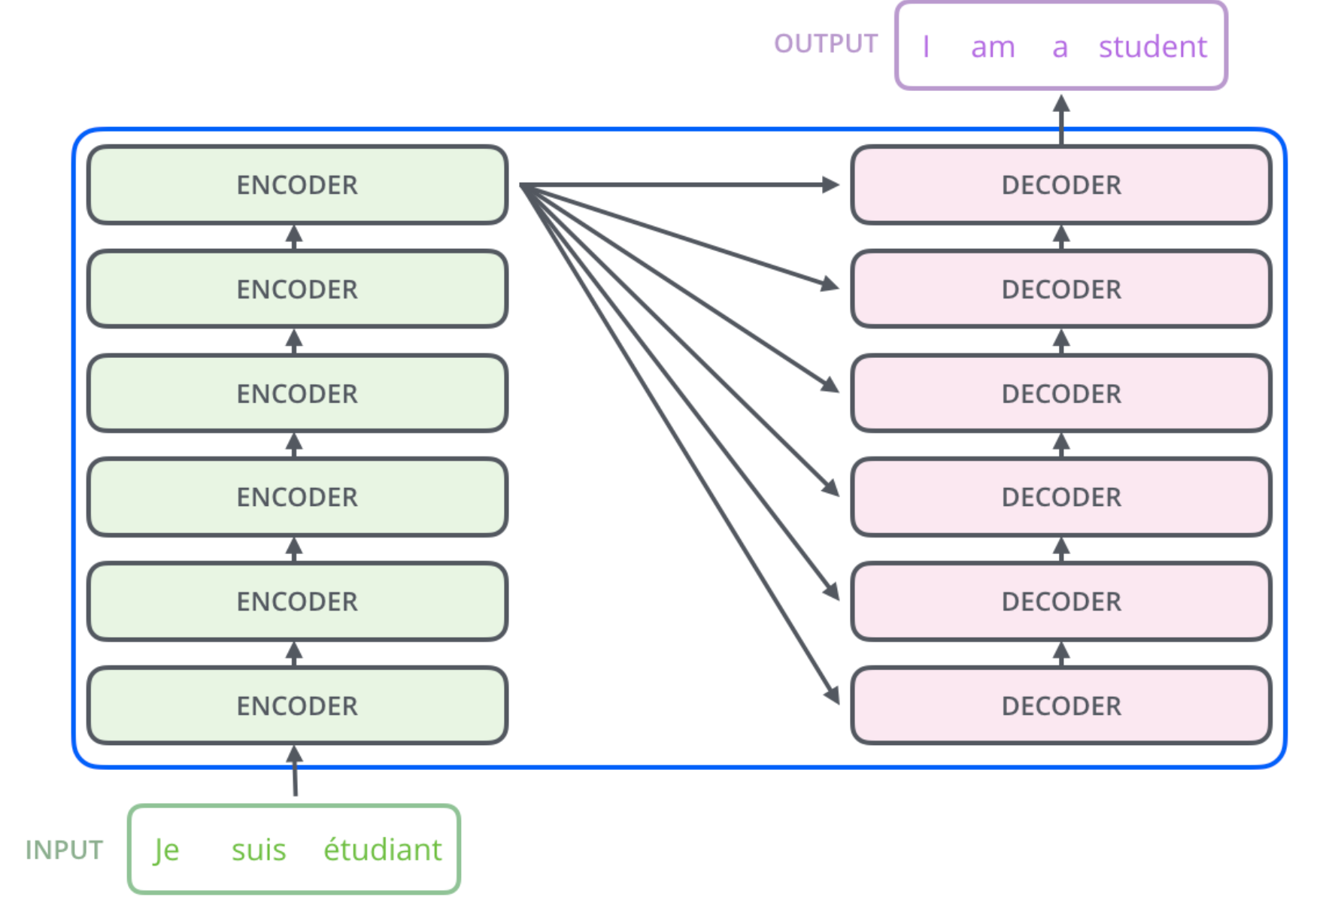
Transformer
- Attention is all you need
Return to sequence modeling
look at the ENCODER(s) part in detail

Slide 23
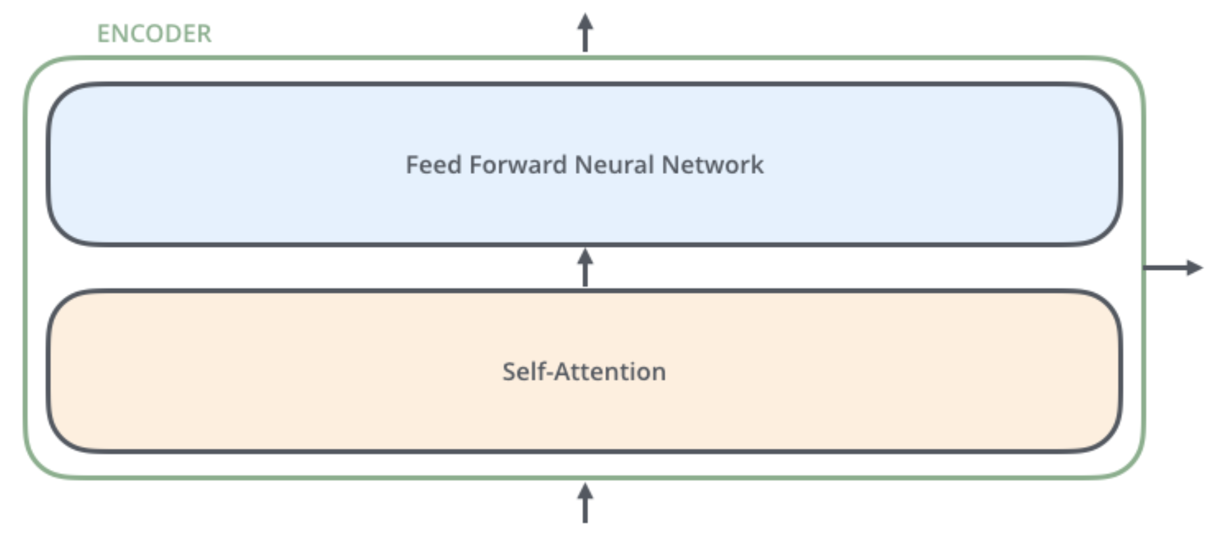
Transformer
- Attention is all you need
Return to sequence modeling
The encoders are all identical in structure (yet they do not share weights). Each one is broken down into two sub-layers
Outputs of the self-attention are fed to a feed-forward neural network. To let the channels exchange messages after the tokens do.
Attention helps the encoder to look at important words as well as aggregates the messages from different tokens.

Slide 24
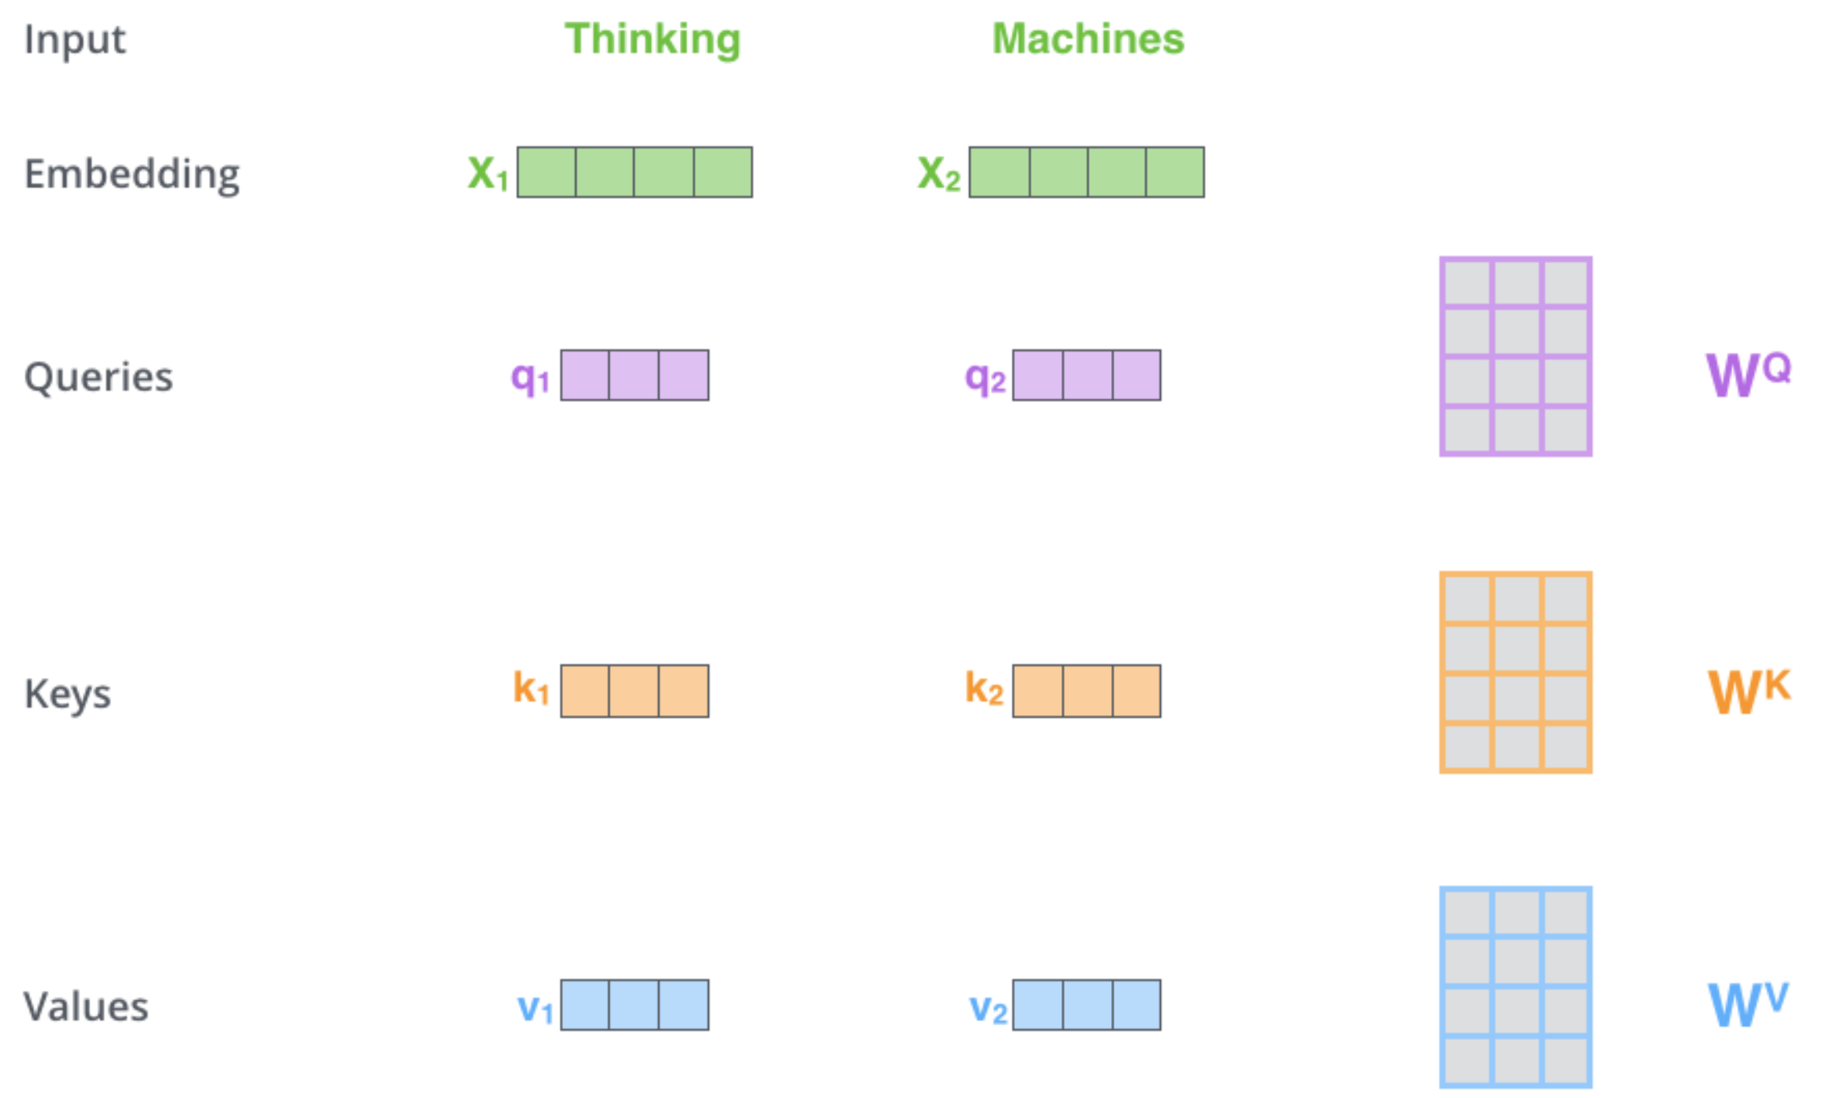
Transformer
- Self-Attention
While processing each word it allows to look at other positions in the input sequence for clues to build a better encoding for this word.
Step1: create three vectors from each of the encoder’s input vectors:
Query, a Key, Value (typically smaller dimension).
by multiplying the embedding by three matrices that we trained during the training process.
Notes:
As the model processes each word (each position in the input sequence), self attention allows it to look at other positions in the input sequence for clues that can help lead to a better encoding for this word.
If you’re familiar with RNNs, think of how maintaining a hidden state allows an RNN to incorporate its representation of previous words/vectors it has processed with the current one it’s processing. Self-attention is the method the Transformer uses to bake the “understanding” of other relevant words into the one we’re currently processing.
The first step in calculating self-attention is to create three vectors from each of the encoder’s input vectors (in this case, the embedding of each word). So for each word, we create a Query vector, a Key vector, and a Value vector. These vectors are created by multiplying the embedding by three matrices that we trained during the training process.
Notice that these new vectors are smaller in dimension than the embedding vector. Their dimensionality is 64, while the embedding and encoder input/output vectors have dimensionality of 512. They don’t HAVE to be smaller, this is an architecture choice to make the computation of multiheaded attention (mostly) constant.

Slide 25
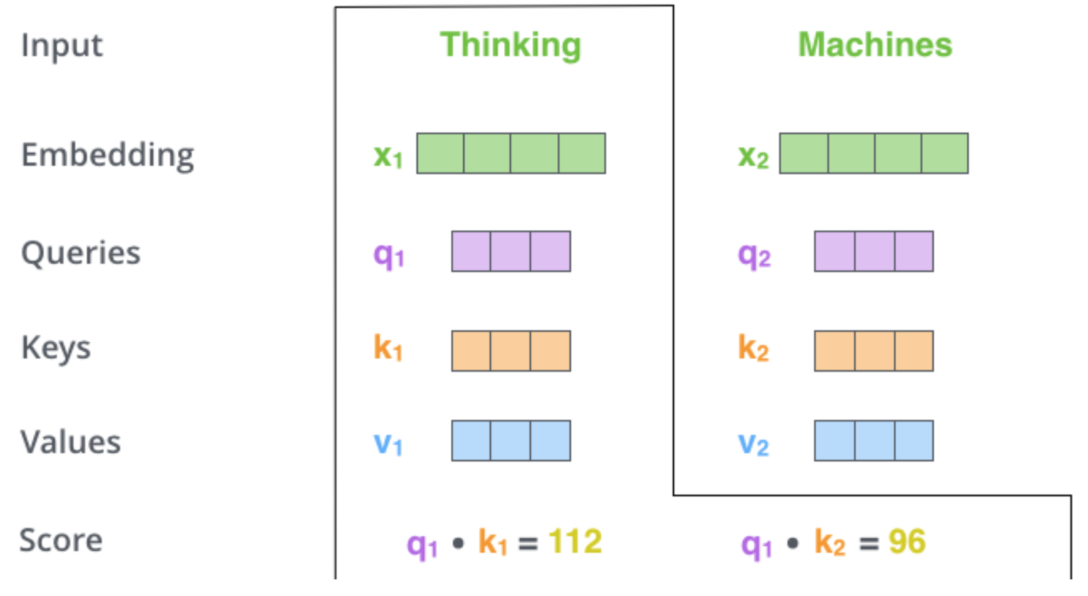
Transformer
- Self-Attention
Step 2: calculate a score (like we have seen for regular attention!) how much focus to place on other parts of the input sentence as we encode a word at a certain position.
Take dot product of the query vector with the key vector of the respective word we’re scoring.
E.g., Processing the self-attention for word “Thinking” in position #1, the first score would be the dot product of q1 and k1. The second score would be the dot product of q1 and k2.
Notes:
The second step in calculating self-attention is to calculate a score. Say we’re calculating the self-attention for the first word in this example, “Thinking”. We need to score each word of the input sentence against this word. The score determines how much focus to place on other parts of the input sentence as we encode a word at a certain position.
The score is calculated by taking the dot product of the query vector with the key vector of the respective word we’re scoring. So if we’re processing the self-attention for the word in position #1, the first score would be the dot product of q1 and k1. The second score would be the dot product of q1 and k2.

Slide 26
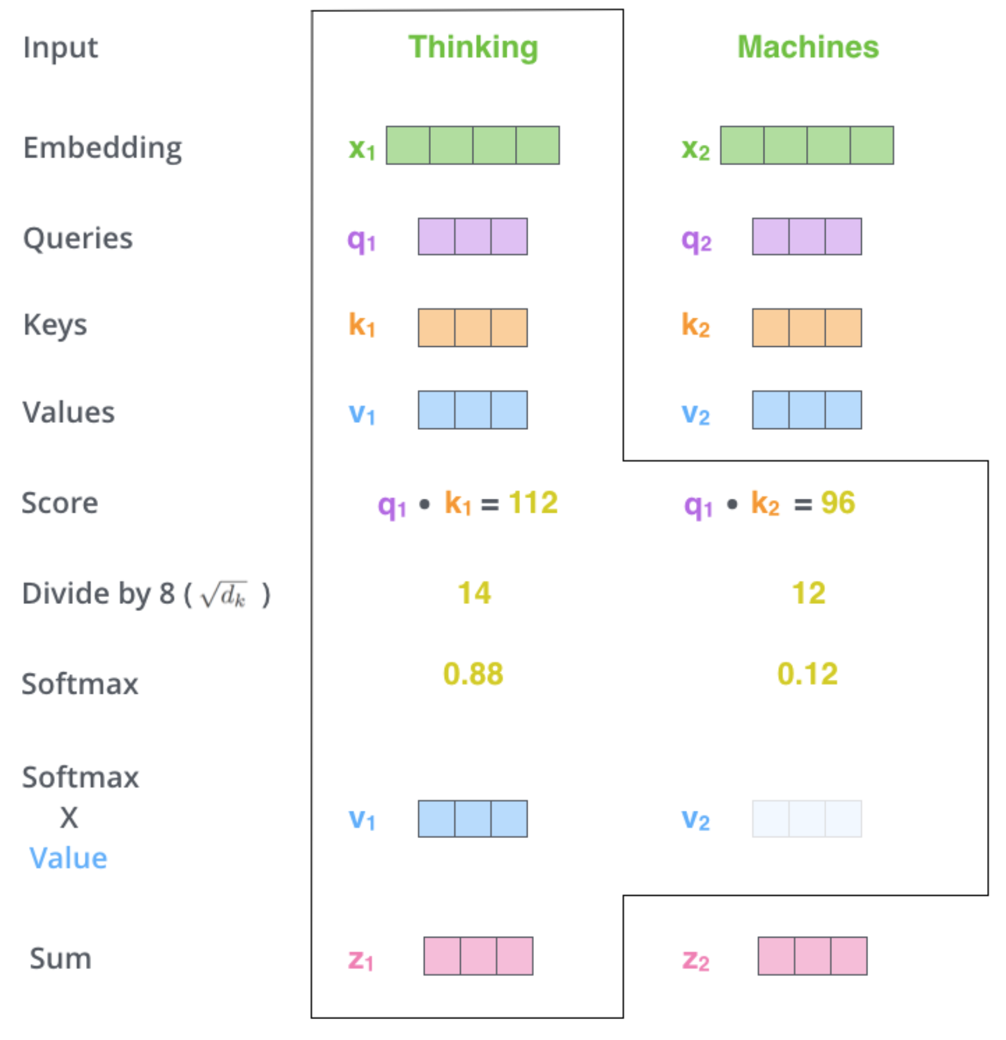
Transformer
- Self-Attention
Step5 : Sum up the weighted value vectors. This produces the output of the self-attention layer at this position
More details:
What we have seen for a word is done for all words (using matrices)
Need to encode position of words
And improved using a mechanism called “multi-headed” attention
(kind of like multiple filters for CNN)
see https://jalammar.github.io/illustrated-transformer/

Slide 27
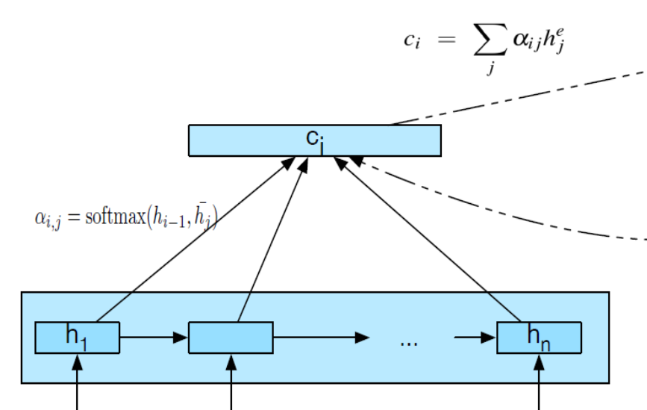
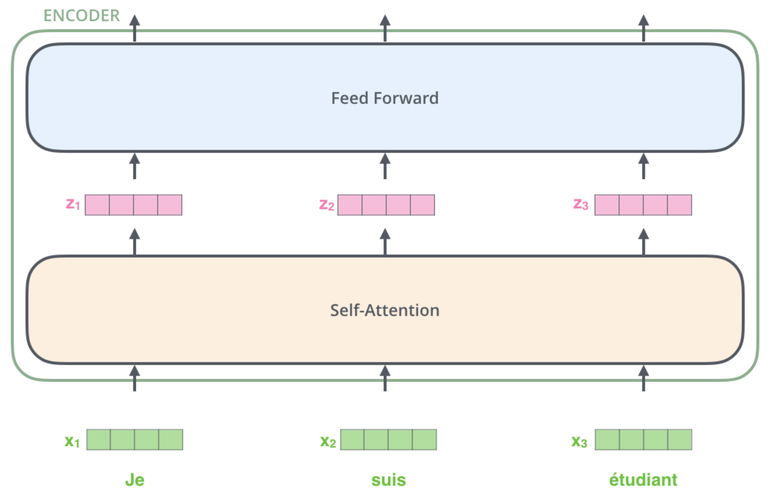
Transformer
- Attention is all you need
Self-attention v.s. Attention
Each token in the sequence can generate a hidden state.
Let the attention mechanism obtained between every pair of hidden state.
For the whole sequence, each token obtain pre- and post-text information through self-attention.

Slide 28
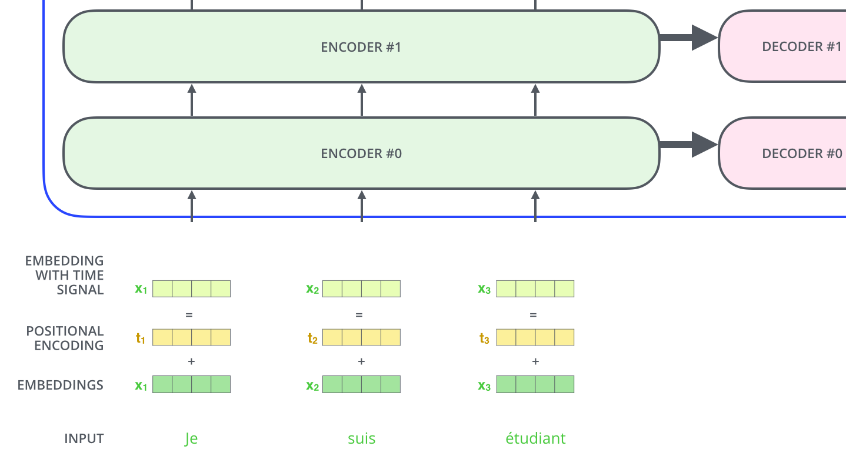
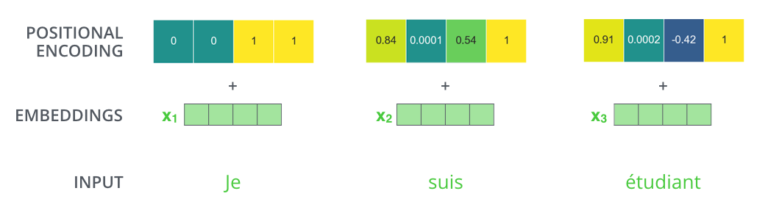
Transformer
- Positional Encoding
Representing The Order of The Sequence Using Positional Encoding
These vectors follow a specific pattern that the model learns, which helps it determine the position of each word, or the distance between different words in the sequence.
Notes:
To address this, the transformer adds a vector to each input embedding. These vectors follow a specific pattern that the model learns, which helps it determine the position of each word, or the distance between different words in the sequence. The intuition here is that adding these values to the embeddings provides meaningful distances between the embedding vectors once they’re projected into Q/K/V vectors and during dot-product attention.

Slide 29

Transformer
- The Residuals
Each sub-layer (self-attention, FFN) in each encoder has a residual connection around it, and is followed by a layer-normalization step
Notes:
To address this, the transformer adds a vector to each input embedding. These vectors follow a specific pattern that the model learns, which helps it determine the position of each word, or the distance between different words in the sequence. The intuition here is that adding these values to the embeddings provides meaningful distances between the embedding vectors once they’re projected into Q/K/V vectors and during dot-product attention.

Slide 30
Transformer
- Attention is all you need
Key property of Transformer: Word in each position flows through its own path in the encoder.
There are dependencies between tokens in the self-attention layer, and attention tries to find them.
Feed-forward layer does not have those dependencies, but they transport different messages along the channels.
Various paths can be executed in parallel.
Word embeddings

Slide 31

Transformer
- Decoder
Relies on most of the concepts on the encoder side
Notes:
We begin the decoding phase. Each step in the decoding phase outputs an element from the output sequence (the English translation sentence in this case).

Slide 32
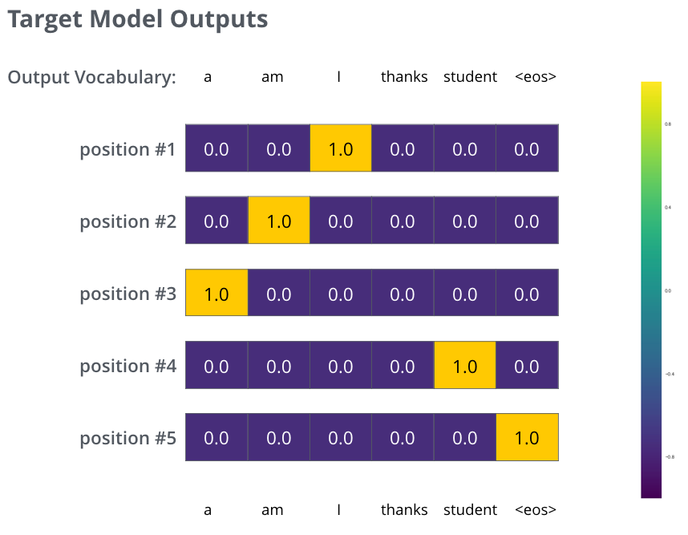
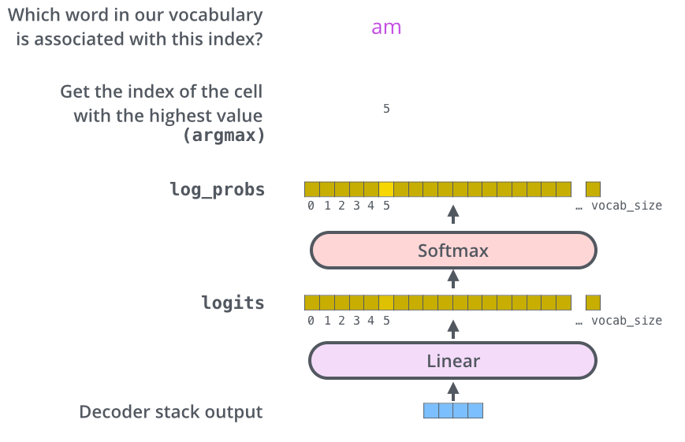
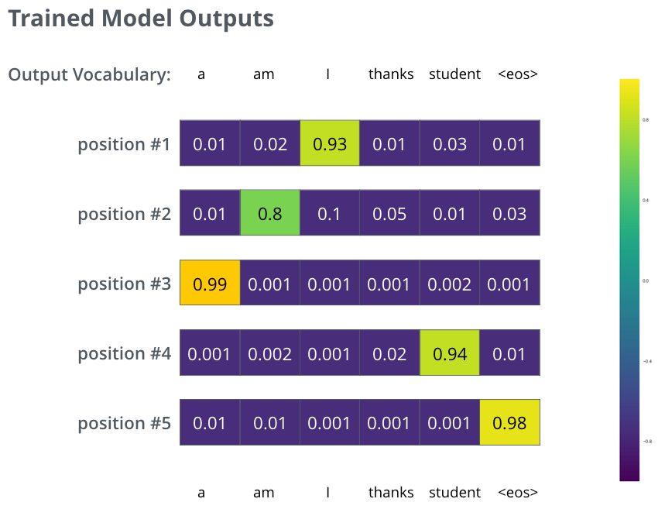
Transformer
- Decoder
The Final Linear and Softmax Layer
Notes:
We begin the decoding phase. Each step in the decoding phase outputs an element from the output sequence (the English translation sentence in this case).
The following steps repeat the process until a special symbol is reached indicating the transformer decoder has completed its output. The output of each step is fed to the bottom decoder in the next time step, and the decoders bubble up their decoding results just like the encoders did. And just like we did with the encoder inputs, we embed and add positional encoding to those decoder inputs to indicate the position of each word.

Slide 33
Vision Transformer
Divide Image
according to patch size
(P x P)
Flatten into a
2-D sequence
(N x P².C)
Large Dataset of Images
1 Image
(H x W x C)
Append a learnable class token
(N+1) x P².C
Continue
CLASS
MLP Head
Add Positional Embeddings
(N+1) x P².C
Linear Projection to fit
Transformer Width
(N + 1) x D
Transformer Encoder
Notes:
Split an image into patches
Flatten the patches
Produce lower-dimensional linear embeddings from the flattened patches
Add positional embeddings
Feed the sequence as an input to a standard transformer encoder
Pretrain the model with image labels (fully supervised on a huge dataset)
Finetune on the downstream dataset for image classification

Slide 34

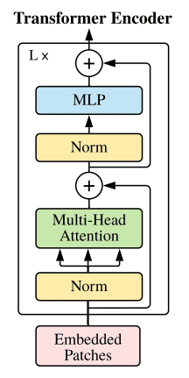
Vision Transformer
Image patches are basically the sequence tokens (like words).
In fact, the encoder block is identical to the original transformer.

Slide 35
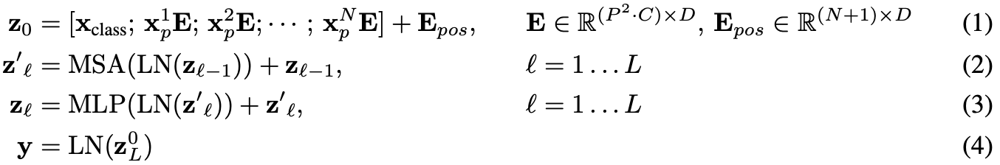
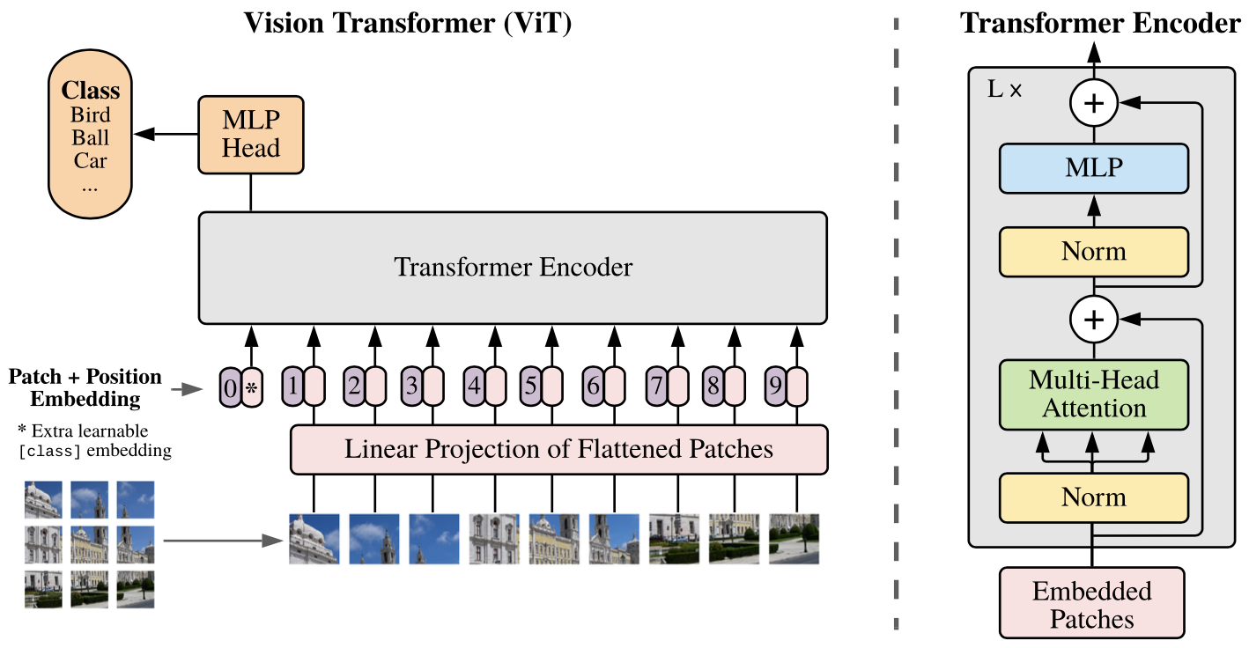
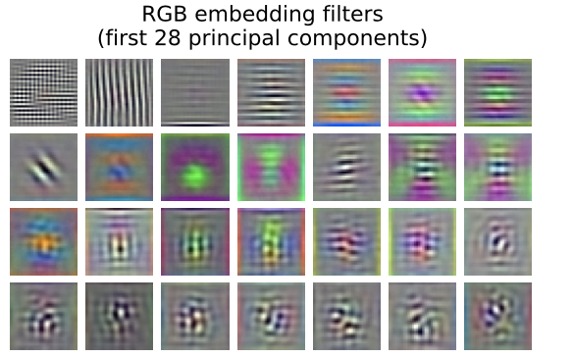
Vision Transformer
Reshape the image $x∈ℝ^{H×W×C}$ into a sequence of flattened 2D patches $x_{p}∈ℝ^{H×(P^{2}C)}$, where $(H,W)$ is the resolution of the original image, each patch is $(P,P)$, and $N=HW/P^{2}$.
linear projection
Muti-head
Self-Attention
Filters of the initial linear embedding of ViT-L/32.

Slide 36
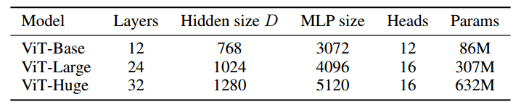
Vision Transformer
The only thing that changes is the number of those blocks. To this end, and to further prove that with more data they can train larger ViT variants, 3 models were proposed:

Slide 37
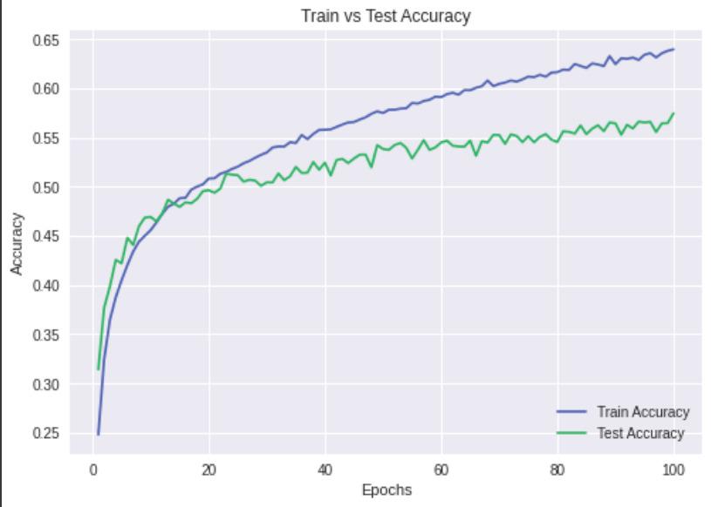
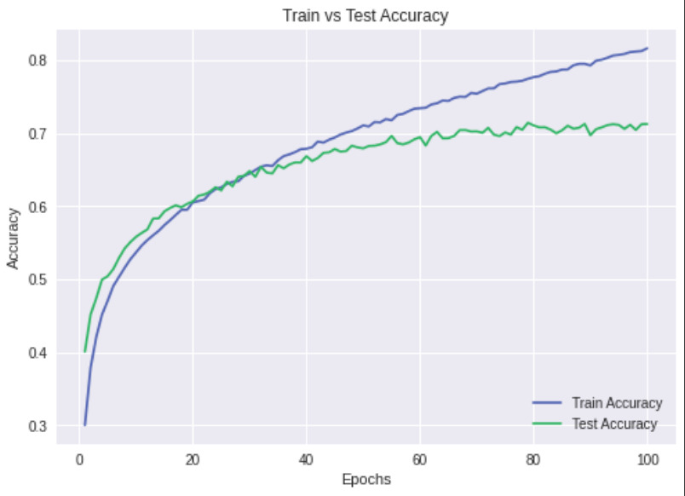
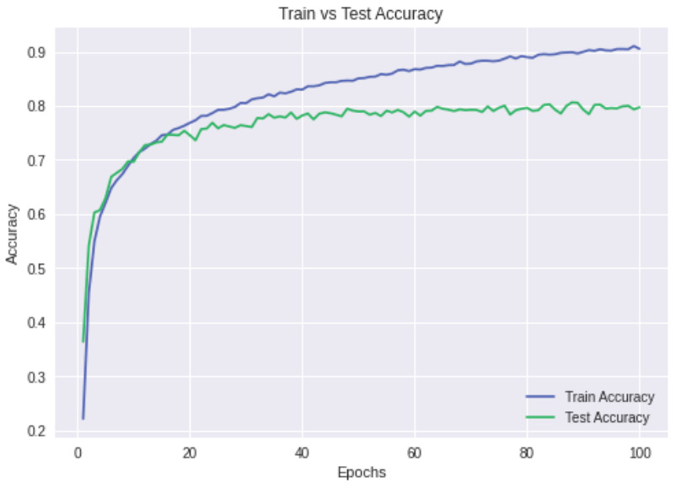
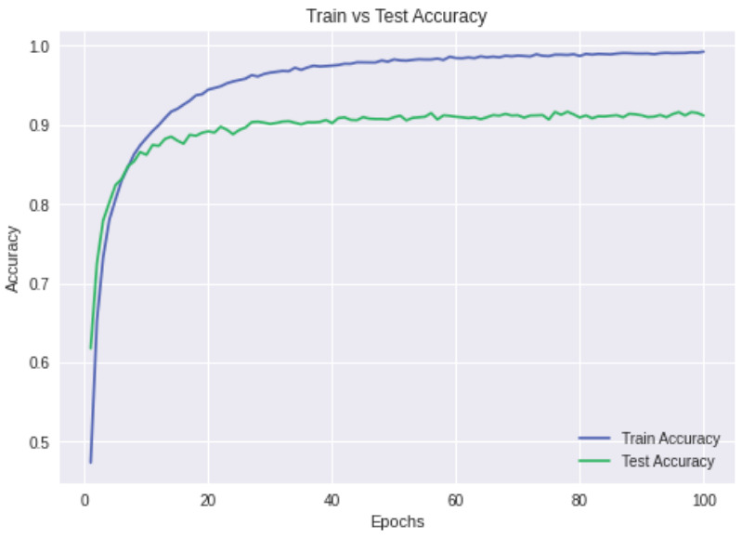
Vision Transformer
Train vs Test Accuracy (CIFAR10)
ViT
Layer - 12
Patch size - 8
ViT
Layer - 12
Patch size - 4
Hybrid ViT
Layer - 12
Patch size - 7
ResNet34

Slide 38
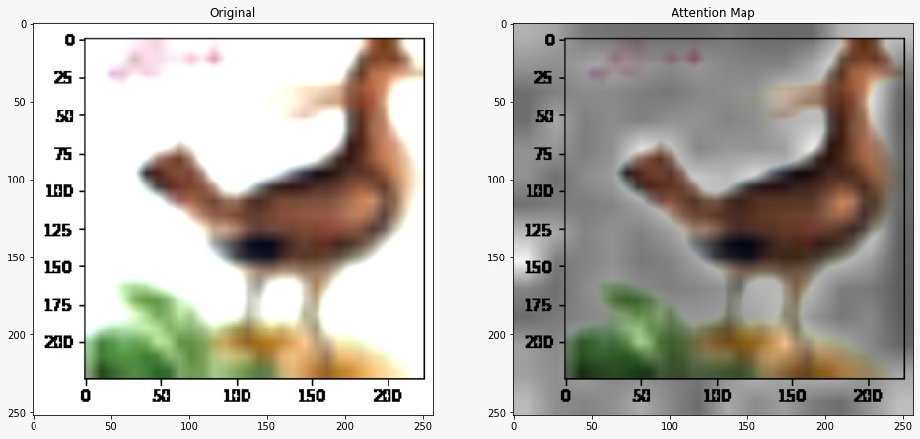
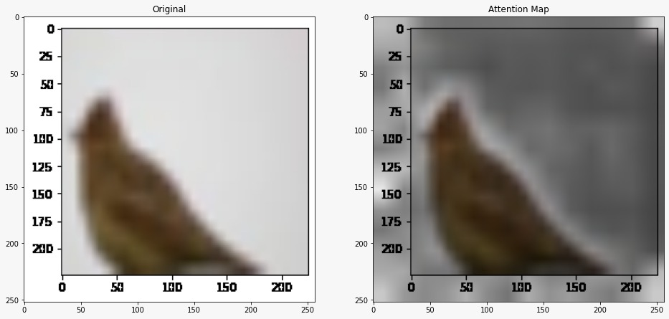
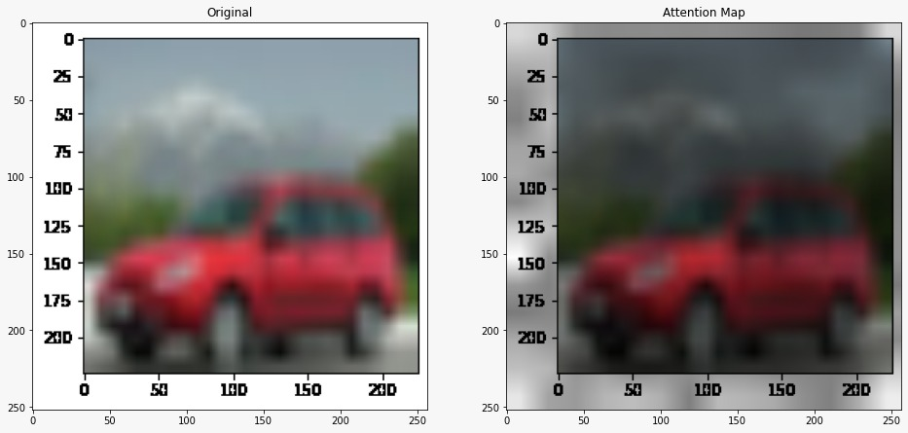
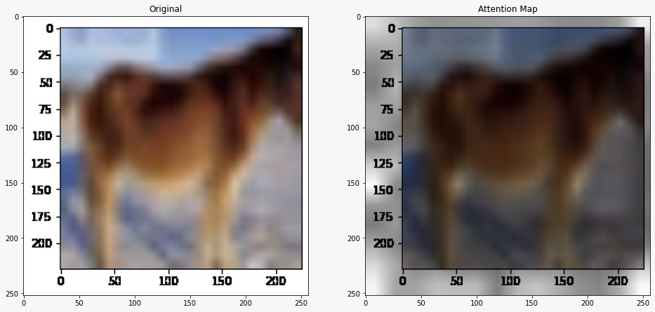
Attention Map Visualization
Vision Transformer
Representative examples of attention from the output token to the input space

Slide 39
Thanks
Acknowledgements:
Selected pictures and contents from:
Andrew Ng, Stanford University, Chris Olah, Google Brain, Fei-Fei Li, Stanford University, Geoffrey Hinton, Google & University of Toronto, Hung-yi Lee, National Taiwan University, Ian Goodfellow, Google Brain, Yann LeCun, New York University, Yoshua Bengio, Universite de Montreal
Jurafsky & Martin 3rd Ed . https://jalammar.github.io/illustrated-transformer/
Giuseppe Carenini, UCB. CA, CPSC 503, Computational Linguistics, Encoder Decoder / Attention/ Transformers /Lecture 15
Hongyi Zhu and Hsinchun Chen, Artificial Intelligence Lab, University of Arizona, An Introduction to Recurrent Neural Networks: Overview, Implementation, and Application

